Slide 1
IIT Delhi Poltu
Etiksha Jain (2020EE10491) Adit Malhotra (2020EE10458)

Slide 2
Theme
In the heart of IIT Delhi, where academia meets ambition, the battleground of college politics unfolds. Take on the role of a student vying for the ultimate honor: the Presidency. Navigate the maze of campus life, from rallying support to facing off in epic duels. Will you rise as a beacon of change or be swallowed by the tide of campus intrigue?

Slide 3
Design Decisions
Added animations everywhere to improve the UX
Incorporated appropriate and interesting sound effects to improve the gaming experience
Used socketing to handle game interactions between players over the shared network
The game design involves strategy and thinking, with a thrilling old fashioned sword battle face off against your rival.
Built everything from scratch using pygame.

Slide 4
Game Structure
Two-Player Game: The game is designed for two players to compete against each other.
Two Rounds:
First Round – Campaigning : Players navigate the campus, completing tasks, spreading propaganda. The score accumulated in this round determines the resources and abilities available in the next round.
Second Round – Duel : The finalists face off in a showdown, armed with swords obtained based on their first-round performance. They engage in a duel until one emerges victorious.

Slide 5
How to Play
Install code from Github, install pygame
Set up a server and two clients playing over the same network,
Start playing Round 1, interact with entities and complete tasks to build your candidature profile for President elections.
After round 1 ends, wait for the other player to complete round 1.
Play a final showdown with the other player to win the elections.
The last standing player wins!

Slide 6
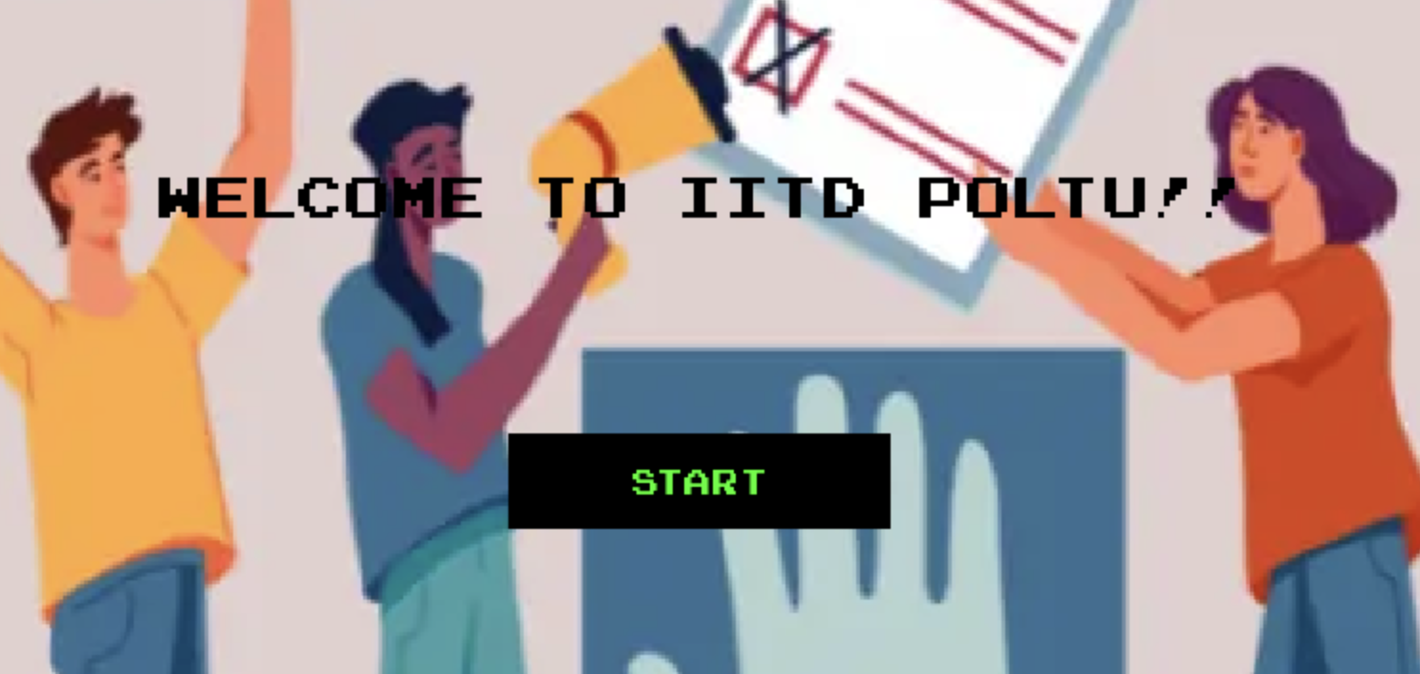
Round 1
Navigate IIT Delhi campus to complete campaigning tasks!
Start the Game whenever you're Ready!

Slide 7
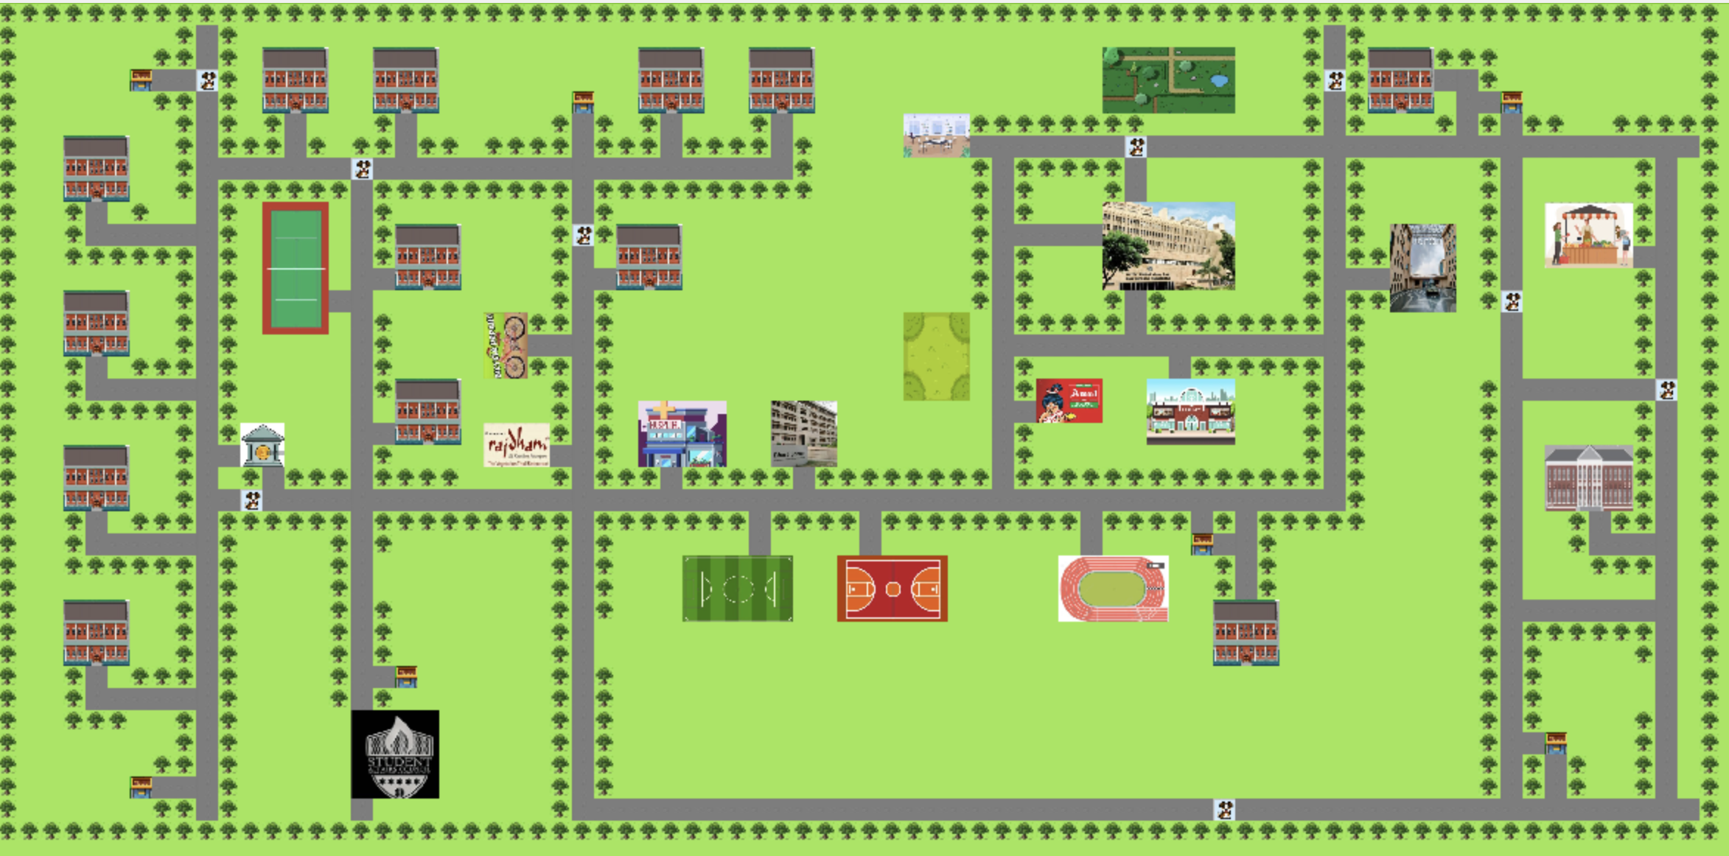
IIT Delhi Map

Slide 8
Player Profile
Instructions
Timer
Health
Coins
Score
Player moves to next round if health goes to zero
Round one ends if either player completes all tasks or the timer reaches to zero
Score is calculated using health, time left and coins collected

Slide 9



Health Recharge
Hospital- Press h
Outlets- Press f
Recharges health to full at cost of 40 points
Increases health by 20 at cost of 10 points

Slide 10
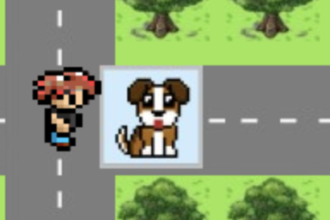
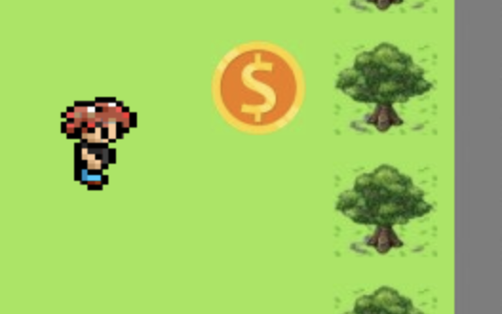
Dogs and Coins
Dogs are NPCs
Coins
Dog collision reduces the health of player 5 units
Each coin is worth 50 points

Slide 11
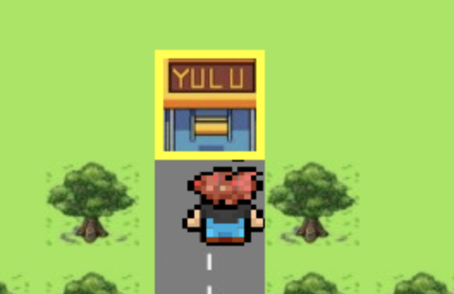
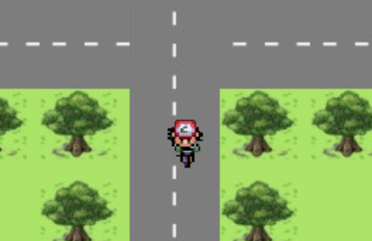
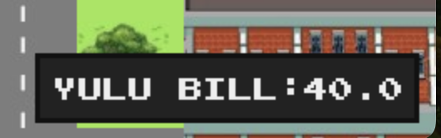
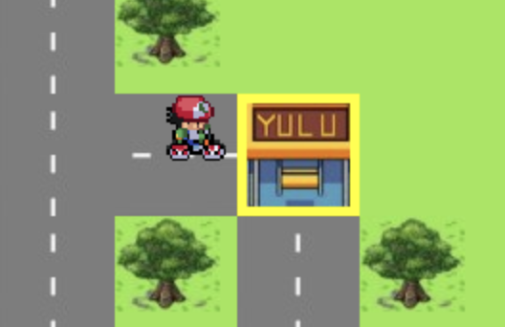
Yulu RIding
Press y to get on Yulu
Bill gets accumulated
Press t to get off yulu

Slide 12
Tasks
The round runs for a fixed time in which the player has to complete as many tasks as possible
The tasks appear one after the other and each task completion earns points
After completing all tasks, the player moves to round two
The sooner the player finishes all tasks, the more the final score

Slide 13
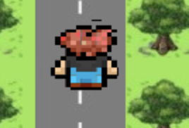
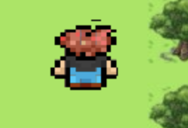
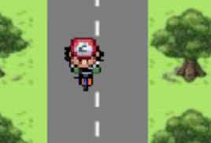
Player Speed
Road
Grass
Yulu
Speed = 4
Energy decreases at a fixed rate
Speed = 2
Energy decreases at rate slower than road
Speed = 6
Energy decreases at fastest rate

Slide 14
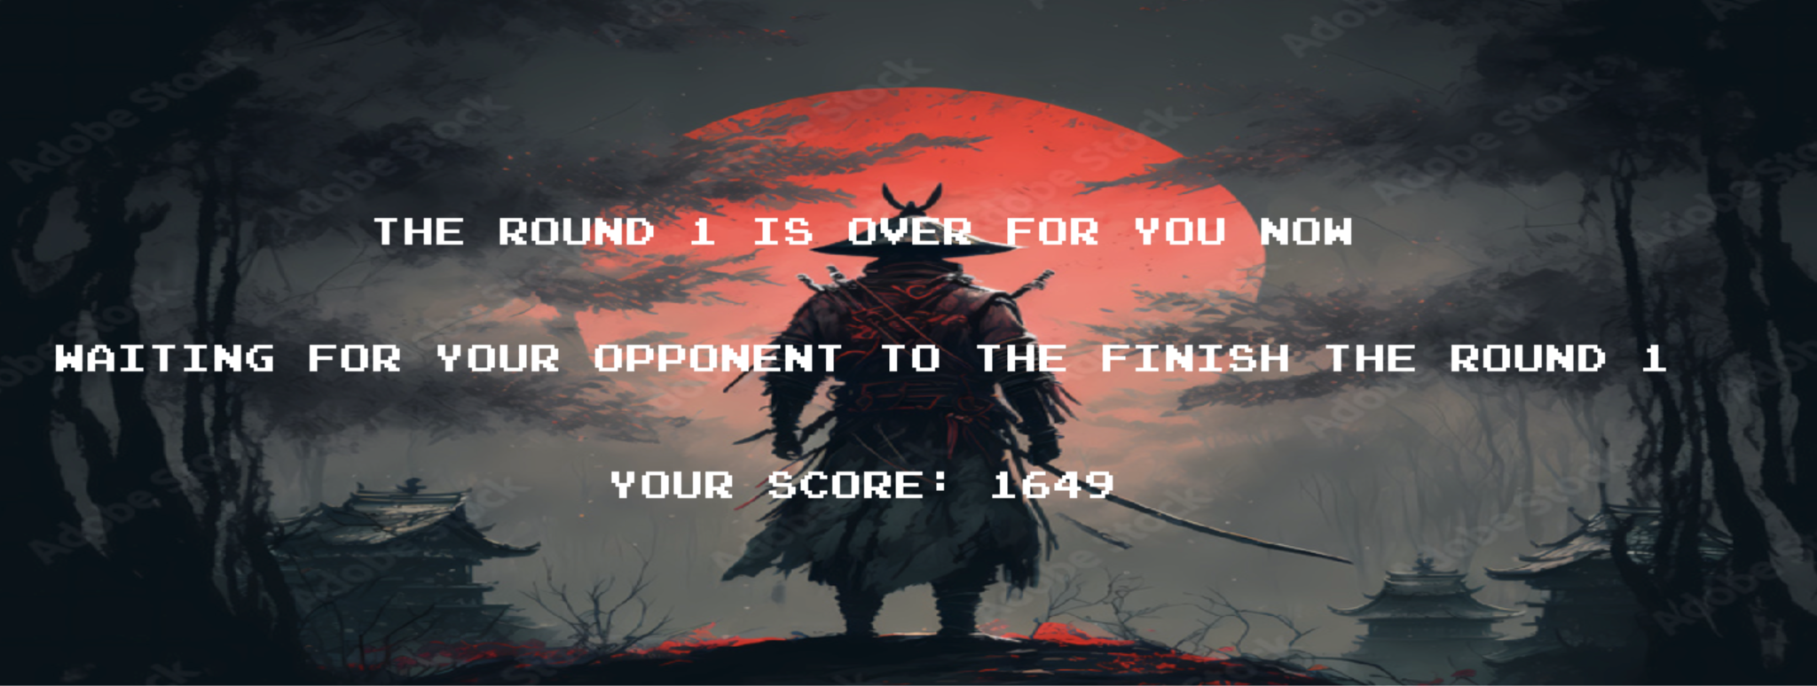
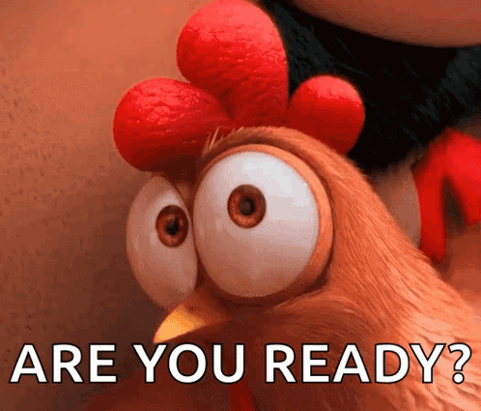
Round 1 Results
Keeps pinging the server to check the status of the second player

Slide 15
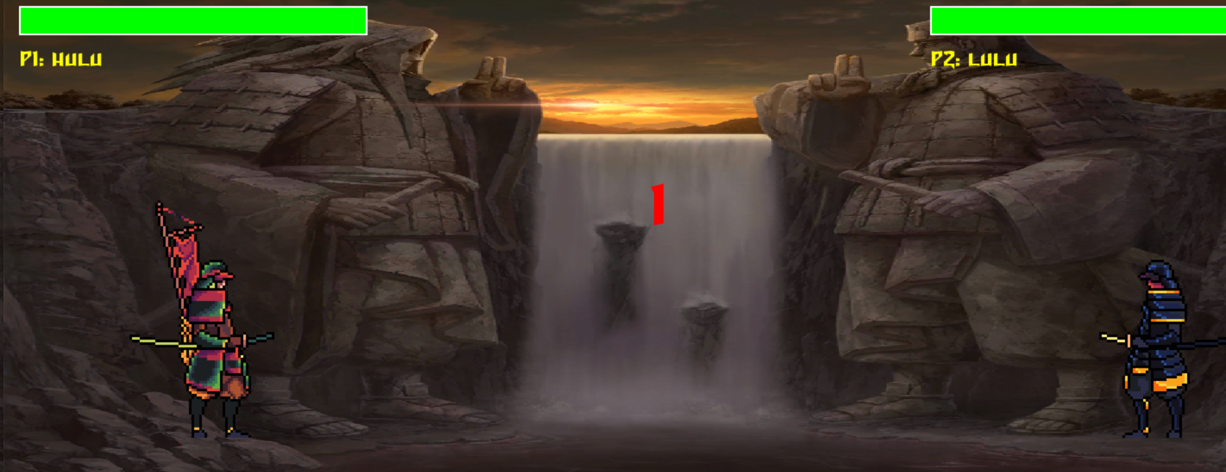
Round 2
Duel between you and your competitor
Starts as soon as both players complete round one
More score
Better sword

Slide 16
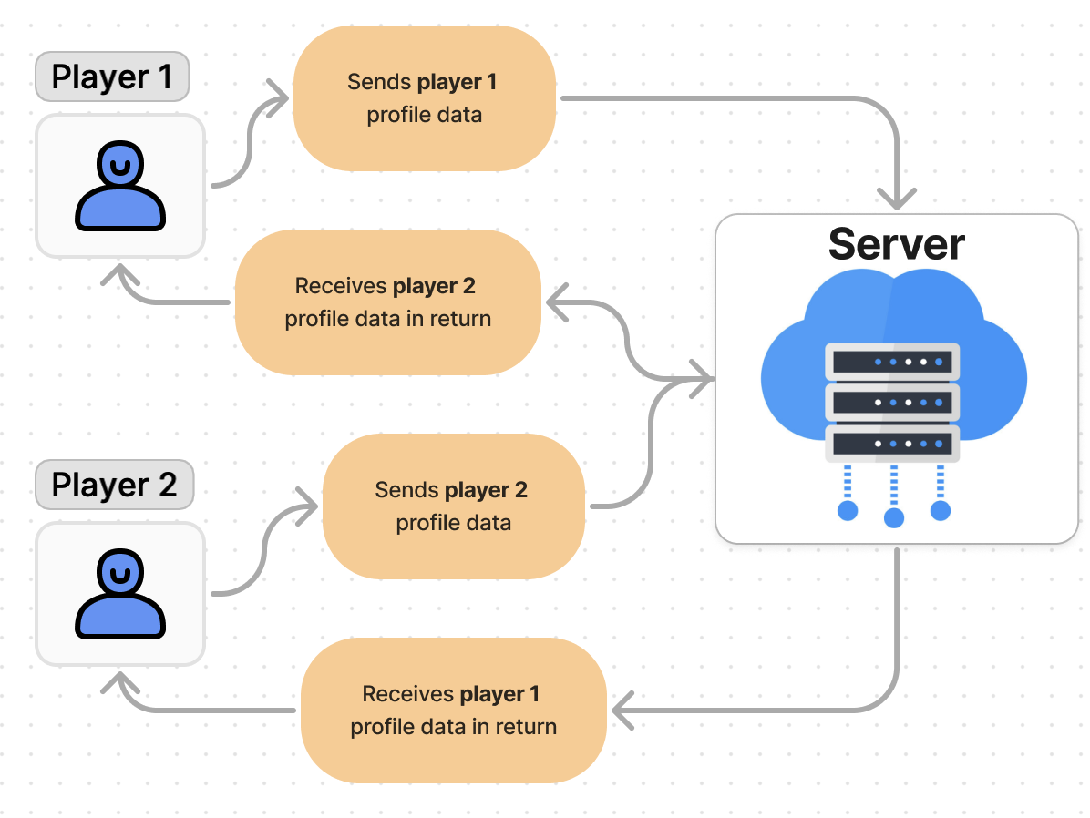
Client-Server Arch
Server stores the profiles data of both players
Overwrites the received profile data and sends the profile data of the opposite player
Prevents race conditions as one thread only reads and other thread only writes to the location

Slide 17
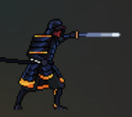
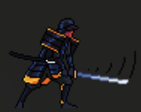
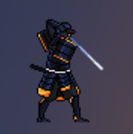
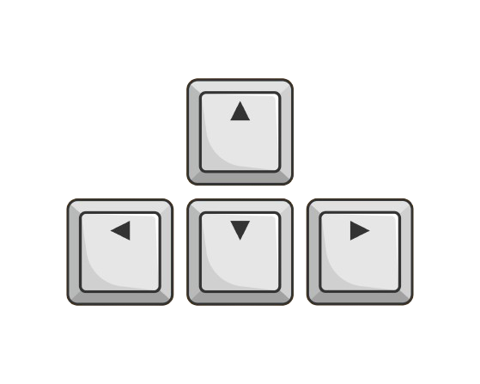
Controls
Attack 1 : Key C
Light Attack
(Lower cooldown)
Attack 2 : Key Z Heavy Attack
(Higher cooldown)
Defense : Key X
(Has cooldown so you can’t block permanently)
Jump
Run left
Run right

Slide 18
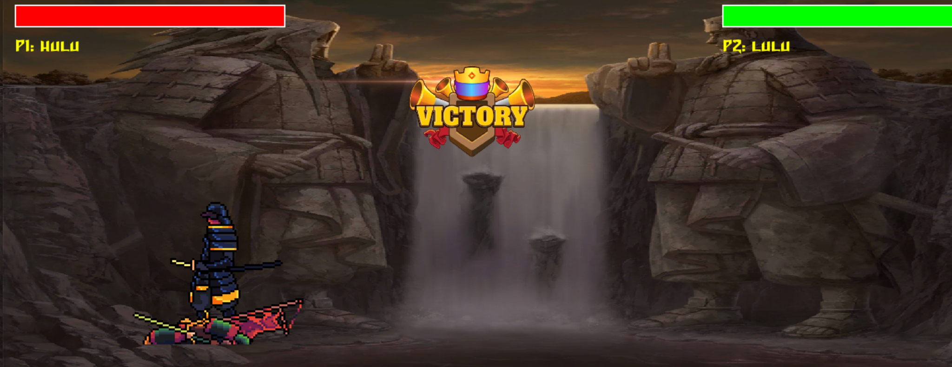
Round 2 Results

Slide 19
THANKS!

